Slide 1

Stock Market Prediction
Team:
Anishish (190040017)
Laxman (190020066)
Riyan (19B080019)
DS 303 (Intro to ML)
Course Project
Notes:
1. Table of contents
2. Introduction
3. Our company
4. Our team
5. Problem
6. Them vs. us
7. Solution
8. SWOT analysis
9. Product overview
10. Our plans
11. Product demo
12. Traction
13. Case study
14. Reviews
15. Awards
16. Market size
17. Target
18. Competitors
19. Business model
20. Timing
21. Predicted growth
22. Investment

Slide 2
Problem
Solution
Predict the future closing value of Nifty 50
Time series forecasting models are capable of predicting future values based on previously observed values.

Slide 3
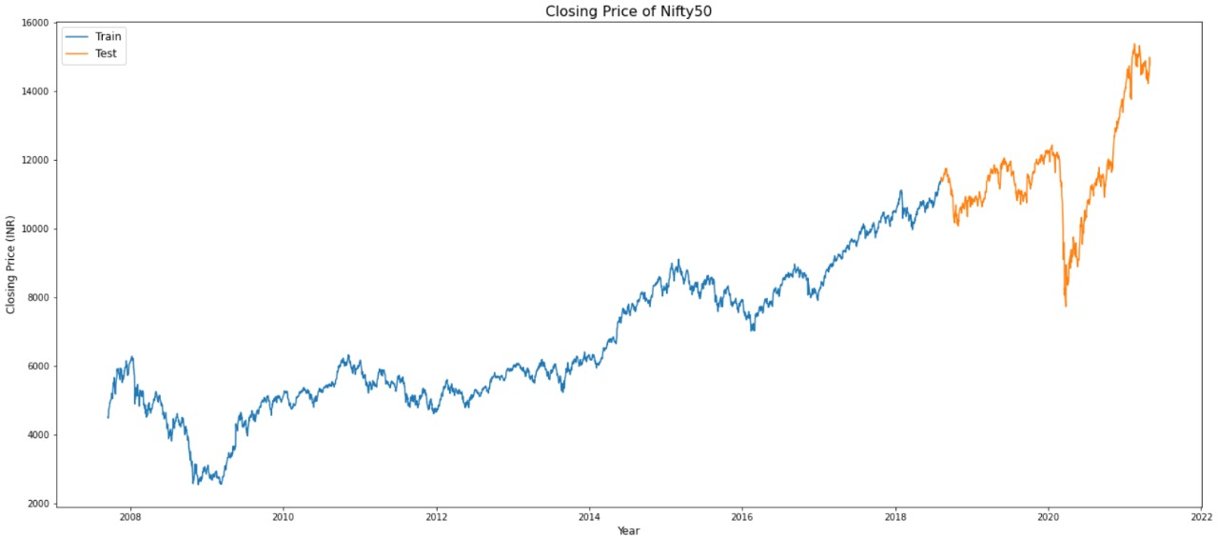
Dataset
Nifty 50 dataset: Yahoo Finance from 2007 to 2021

Slide 4
Models Used:
Model | Training Error (RMSE) | Testing Error (RMSE)
ARIMA | - | 177
Vanilla LSTM | 96 | 278
Stacked LSTM | 99 | 390
Bidirectional LSTM | 105 | 1430
CNN | 86 | 210
CNN-LSTM | 120 | 302

Slide 5
Preprocessing Steps
Removing irrelevant features
Imputing
Train-test split the time series data
Scaling
Create time windows

Slide 6

Preprocessing Steps
1. Removing Irrelevant Features:
Features removed included Volume
2. Imputation:
Data didn’t contain null values, and thus no need to replace them.

Slide 7
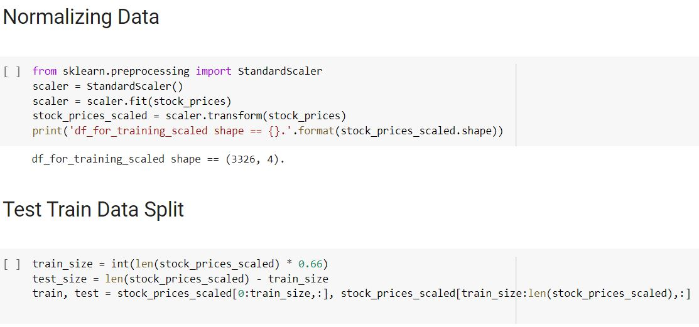
Preprocessing Steps
3. Train Test Split (2/3rd Train)
The time series data wasn’t shuffled. Training was done on 2013-19 data and testing on 2020-21 data.
4. Scaling
Standard Scalar was used to speed up computation

Slide 8
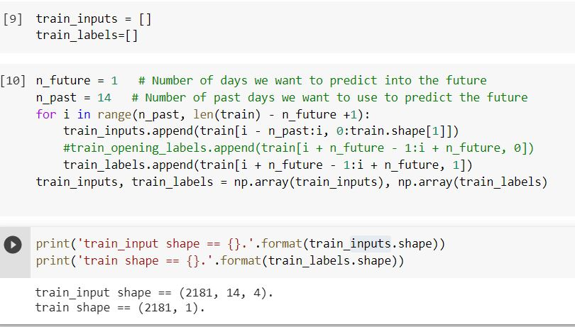
Preprocessing Steps
5. Create time windows
Time sequences were created of window size 14 days.
Data was trained on each sample for 14 days to predict the 15th day.

Slide 9
Long Short Term Memory - LSTM
Long Short Term Memory networks – usually just called “LSTMs” – are a special kind of RNN, capable of learning long-term dependencies.Remembering information for long periods of time is practically their default behavior, not something they struggle to learn! All recurrent neural networks have the form of a chain of repeating modules of neural network. In standard RNNs, this repeating module will have a very simple structure, such as a single tanh layer.LSTMs also have this chain like structure, but the repeating module has a different structure. Instead of having a single neural network layer, there are four, interacting in a very special way.
The key to LSTMs is the cell state, it does have the ability to remove or add information to the cell state, carefully regulated by structures called gates.
Gates are a way to optionally let information through. They are composed out of a sigmoid neural net layer and a pointwise multiplication operation.The sigmoid layer outputs numbers between zero and one, describing how much of each component should be let through.

Slide 10
Arima
AutoRegressive Integrated Moving Average (ARIMA) is a model that captures a suite of different standard temporal structures in time series data.
p: The number of lag observations included in the model, also called the lag order.
d: The number of times that the raw observations are differenced, also called the degree of differencing.
q: The size of the moving average window, also called the order of moving average.

Slide 11
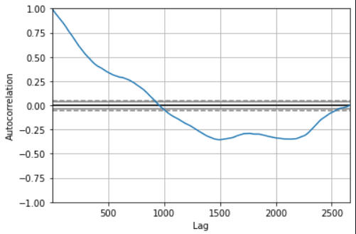
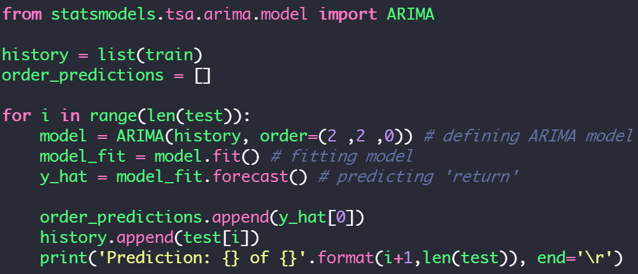
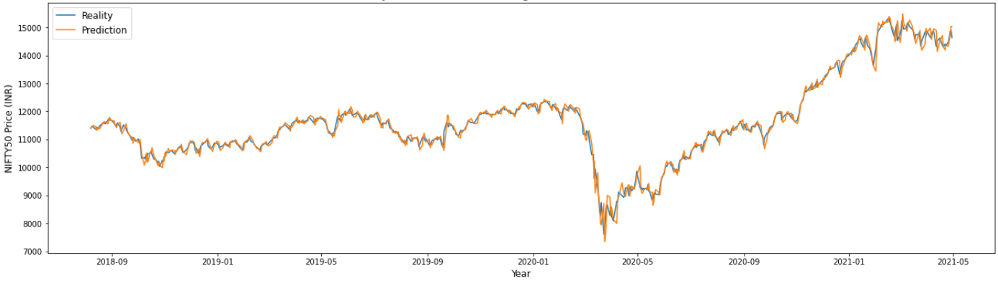
ARIMA Algorithm
Autocorrelation vs Lag
ARIMA Test data graph,
RMSE value: 177.27

Slide 12
Vanila LSTM
A Vanilla LSTM is an LSTM model that has a single hidden layer of LSTM units, and an output layer used to make a prediction.Shape of the input is key in defining the model. The number of time steps as input is the number we chose when preparing our dataset as an argument. The model is fit using the efficient Adam version of stochastic gradient descent and optimized using the mean squared error, or ‘mse‘ loss function.This model expects the input shape to be three-dimensional and requires reshaping to the single input sample before making the prediction.

Slide 13
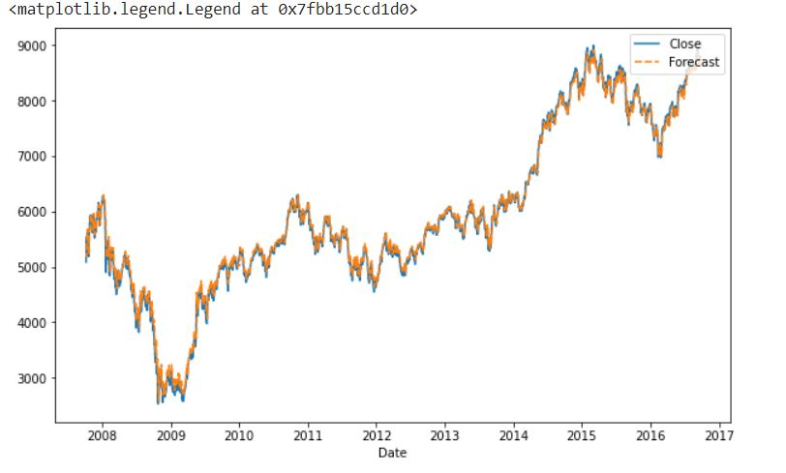
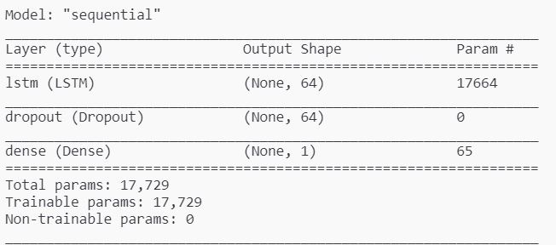
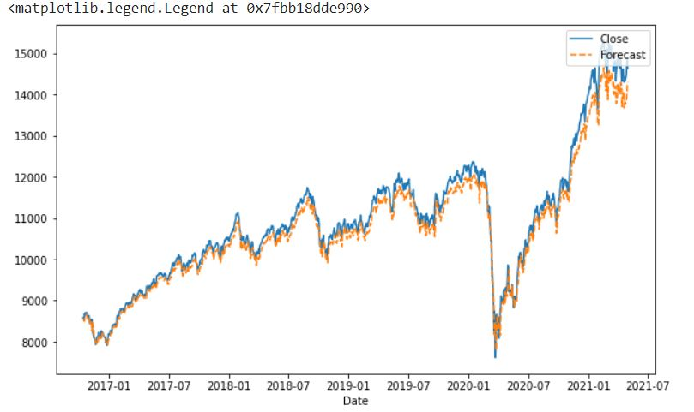
LSTM Model Design
LSTM Train data graph, RMSE value: 96.03
LSTM Test data graph, RMSE value: 278.97

Slide 14
Stacked LSTM
Multiple hidden LSTM layers can be stacked one on top of another in what is referred to as a Stacked LSTM model.
An LSTM layer requires a three-dimensional input and LSTMs by default will produce a two-dimensional output as an interpretation from the end of the sequence.
This model addresses this by having the LSTM output a value for each time step in the input data by setting the return_sequences=True argument on the layer which enables us to have 3D output from hidden LSTM layer as input to the next.

Slide 15
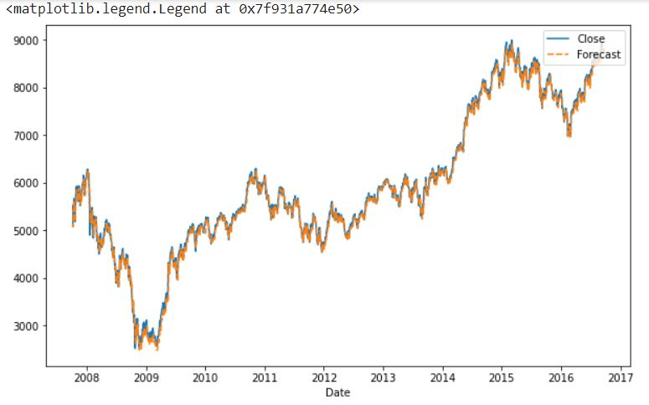
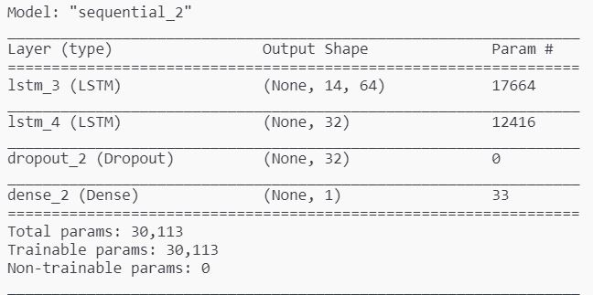
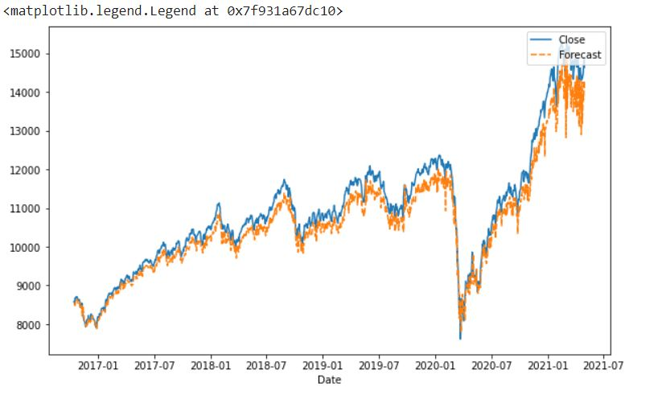
Stacked LSTM model design
Stacked LSTM train graph, RMSE: 99.89
Stacked LSTM test graph, RMSE: 390.2

Slide 16
Bi-directional LSTM
Bidirectional LSTM model allows the LSTM model to learn the input sequence both forward and backwards and concatenate both interpretations. This can be beneficial on some sequence prediction problems.
A Bidirectional LSTM for univariate time series forecasting can be implemented by wrapping the first hidden layer in a wrapper layer called Bidirectional.

Slide 17
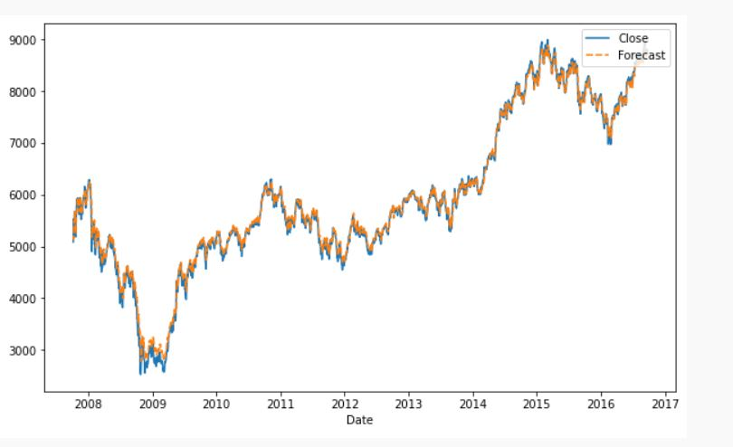
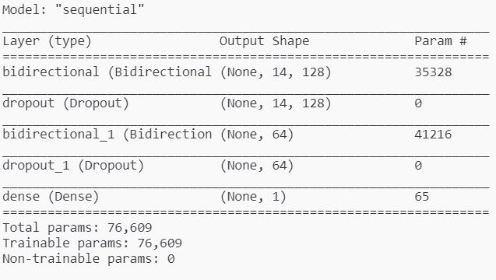
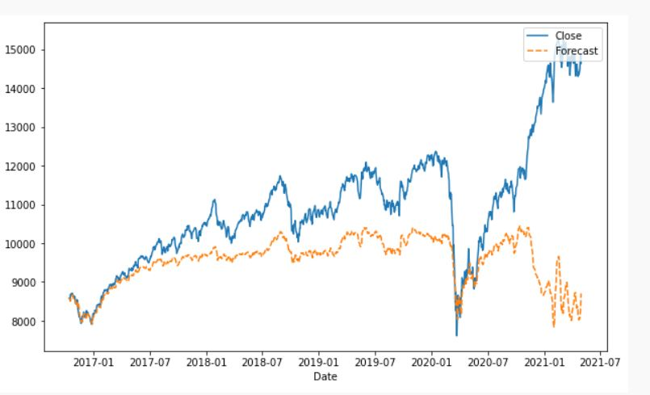
Bi-Directional LSTM Model
Bi-Directional LSTM train graph, RMSE: 105.69
Bi-Directional LSTM test graph, RMSE: 1430.30

Slide 18
CNN
A convolutional neural network, or CNN for short, is a type of neural network developed for working with two-dimensional image data.
The CNN can be very effective at automatically extracting and learning features from one-dimensional sequence data such as univariate time series data.

Slide 19
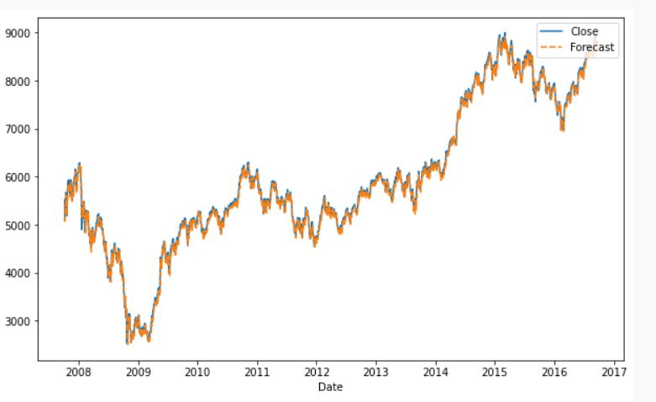
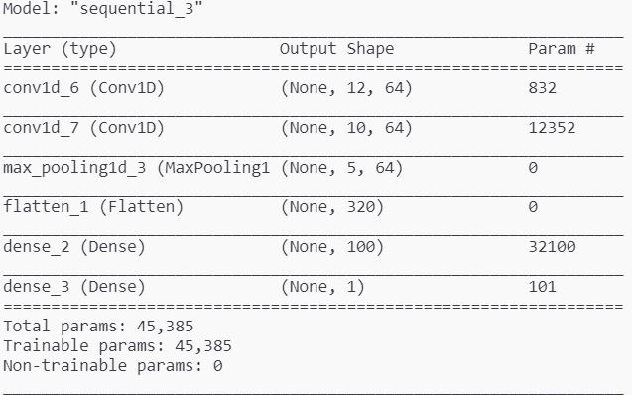
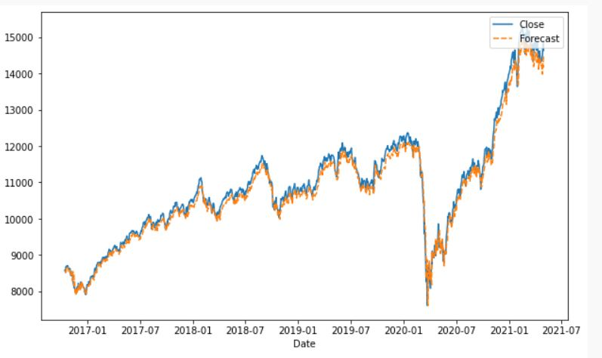
CNN Model
CNN train graph, RMSE: 86.29
CNN test graph, RMSE: 210.67

Slide 20
CNN-LSTM
A CNN model can be used in a hybrid model with an LSTM backend where the CNN is used to interpret subsequences of input that together are provided as a sequence to an LSTM model to interpret.
In this model, the first step is to split the input sequences into subsequences that can be processed by the CNN model.Each sample can then be split into two sub-samples, each with two time steps. The CNN can interpret each subsequence of two time steps and provide a time series of interpretations of the subsequences to the LSTM model to process as input.
The CNN model first has a convolutional layer for reading across the subsequence that requires a number of filters and a kernel size to be specified. The number of filters is the number of reads or interpretations of the input sequence. The kernel size is the number of time steps included of each ‘read’ operation of the input sequence.
The convolution layer is followed by a max pooling layer that distills the filter maps down to 1/2 of their size that includes the most salient features. These structures are then flattened down to a single one-dimensional vector to be used as a single input time step to the LSTM layer.

Slide 21
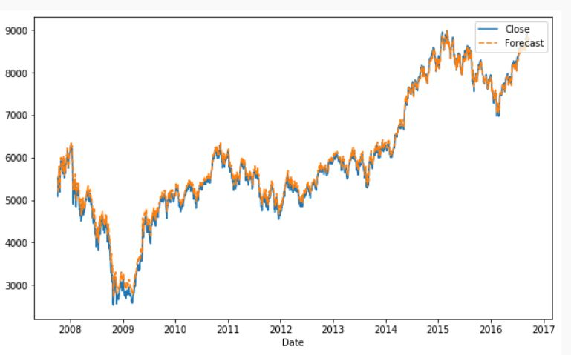
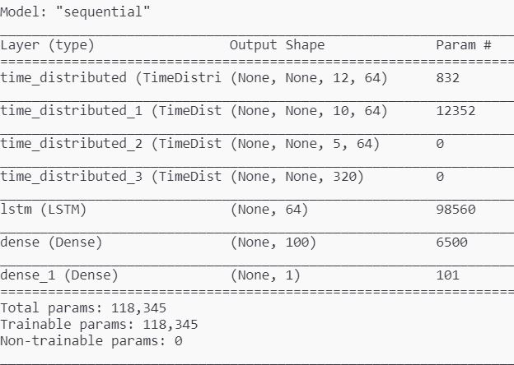
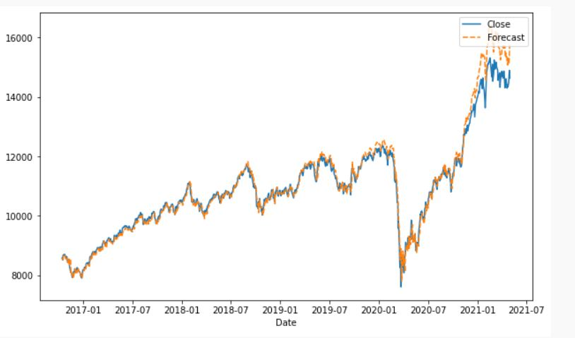
CNN-LSTM Model
CNN-LSTM train graph, RMSE: 120.97
CNN-LSTM test graph, RMSE: 302.03

Slide 22
REFERENCES:
https://machinelearningmastery.com/how-to-develop-lstm-models-for-time-series-forecasting/
https://in.finance.yahoo.com/quote/%5ENSEI/history?period1=1190073600&period2=1620432000&interval=1mo&filter=history&frequency=1mo&includeAdjustedClose=true
https://machinelearningmastery.com/arima-for-time-series-forecasting-with-python/#:~:text=Autoregressive%20Integrated%20Moving%20Average%20Model,and%20forecasting%20time%20series%20data.&text=The%20use%20of%20differencing%20of,make%20the%20time%20series%20stationary.
https://in.tradingview.com/chart/

Slide 23
CONTRIBUTION:
Anishish Sharan (190040017):
Vanilla LSTM
Bi-Directional LSTM
CNN
CNN-LSTM
Laxman Desai (190020066):
ARIMA
Stacked LSTM
Slides
Riyan Jain (19B080019):
Data Acquisition & Cleaning
Normalization
Test & Train split
Slides

